Slide 1
Collaborative Filtering
Notes:
https://medium.com/qiubingcheng/%E5%8D%8A%E5%B0%8F%E6%99%82%E6%89%93%E9%80%A0%E7%B0%A1%E5%96%AE%E5%AF%A6%E7%94%A8%E7%9A%84%E9%9B%BB%E5%BD%B1%E6%8E%A8%E8%96%A6%E7%B3%BB%E7%B5%B1-%E9%99%84%E5%AE%8C%E6%95%B4python%E7%A8%8B%E5%BC%8F%E7%A2%BC-b372769939af
https://medium.com/qiubingcheng/%E4%BB%A5python%E5%AF%A6%E7%8F%BE%E6%8E%A8%E8%96%A6%E7%B3%BB%E7%B5%B1%E7%9A%84%E5%8D%94%E5%90%8C%E9%81%8E%E6%BF%BE%E7%AE%97%E6%B3%95-d35cc1a1ec8a

Slide 2
Outline
Recommendation System
Netflix Research: Recommendations
Collaborative Filtering
Case Study
Conclusion

Slide 3
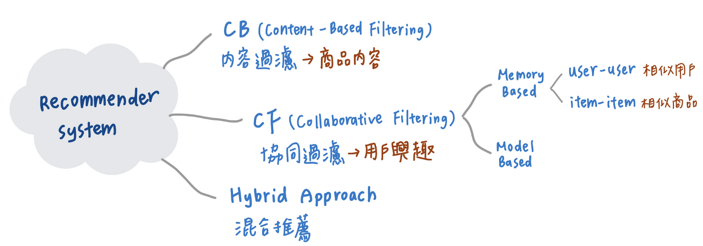
Recommendations System
???

Slide 4
Netflix Research: Recommendations
video 2:30
Notes:
https://www.youtube.com/watch?v=f8OK1HBEgn0
https://research.netflix.com/research-area/recommendations

Slide 5
Netflix Research: Recommendations
"Consumer research suggests that a typical Netﬂix member loses interest after perhaps 60 to 90 seconds of choosing, having reviewed 10 to 20 titles (perhaps 3 in detail) on one or two screens. Therefore, Netflix needs to find a way to suggest to you the best content they have in order to satisfy your expectations, and hopefully under that time window before the user abandons the session.
they needed to use digital services that could make it easier for the consumer to search for products (yes, Netflix uses recommender systems for this task).
Notes:
https://www.linkedin.com/pulse/episode-9-how-netflix-recommends-shows-movies-favio-vazquez

Slide 6
Recommendations System
a subclass of information filtering, which leverages machine learning techniques to determine customers’ preferences to generate a ranked list of relevant items for customers based on users’ past behaviors and similarities (Mora et al. 2020).
The 2 most common methods to solve this problem are
content-based algorithms
collaborative filtering.
go to the system perspective. What we want is to leverage algorithms that can pick an object and recommend it to you.

Slide 7
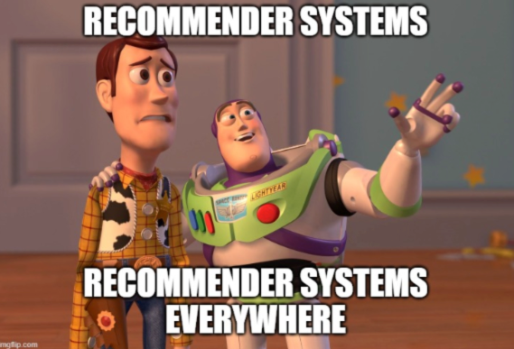
Recommendations System
Questions Netflix’s made to learn more about the users:
When you pause, rewind, or fast forward
Day of the weekend
Date
Time (Hour)
Location (Demographics)
Type of device
When you pause and leave content (and if you ever come back)
Searches (about 3 million per day)
Browsing and scrolling behavior
If you are changing the language
Are you using subtitles?
Did you turn on more than one device?

Slide 8
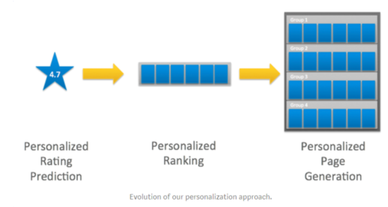
Recommendations System
Their motivation is to help users find movies and shows that fit their tastes because they are more likely to maintain a subscription
It saves $1 billion to Netflix per year.
The recommender system can influence users’ choice for about 80% of hours streamed at Netﬂix.
Movies and shows exposure to users. The effective catalog size (ECS) is a metric that describes how spread viewing is across the items in our catalog (see image below).

Slide 9
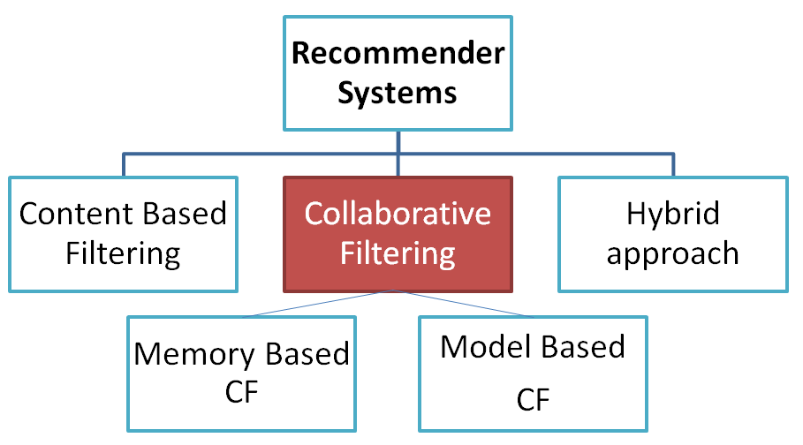
Collaborative Filtering
Collaborative filtering is a technique that can filter out items that a user might like on the basis of reactions by similar users.
Memory-based 的演算法主要使用統計方法對資料進行相似度的計算，而另一種 Model-based 的協同過濾則透過模型的建立對資料進行訓練或計算
Notes:
https://www.youtube.com/watch?v=n3RKsY2H-NE&ab_channel=ArtoftheProblem

Slide 10
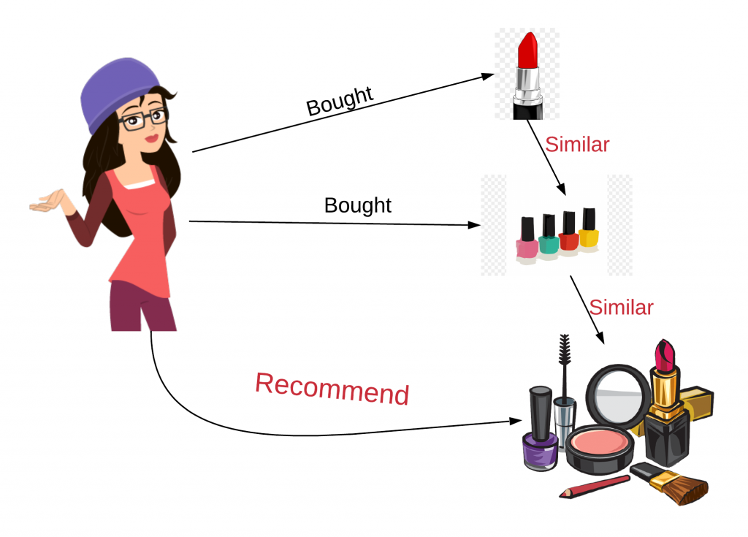
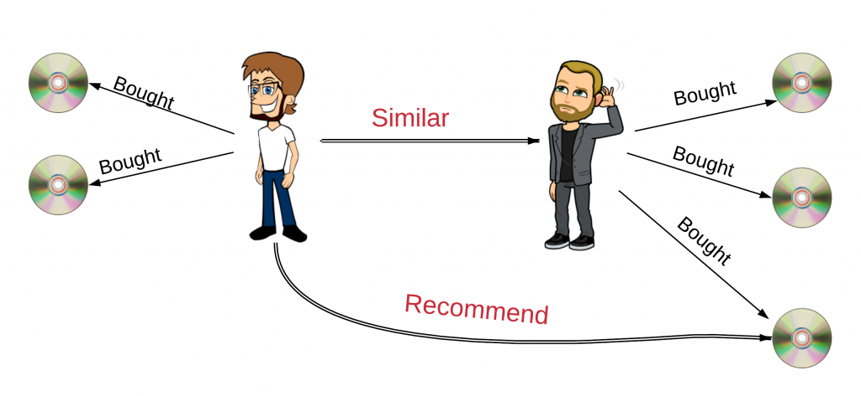
Collaborative Filtering
Collaborative filtering is a technique that can filter out items that a user might like on the basis of reactions by similar users.
User-based / USER-USER / (belongs to Memory-based)
Item-based / ITEM-ITEM
Notes:
https://ithelp.ithome.com.tw/articles/10219511

Slide 11
Collaborative Filtering
Cold Start

Slide 12
Collaborative Filtering
The feedback about movies falls into one of two categories:
Explicit— users specify how much they liked a particular movie by providing a numerical rating.
Implicit— if a user watches a movie, the system infers that the user is interested.
When a user visits the homepage, the system should recommend movies based on both:
similarity to movies the user has liked in the past
movies that similar users liked
Notes:
https://jacklu2016.github.io/2020/03/12/%E6%8E%A8%E8%8D%90%E7%B3%BB%E7%BB%9F-%E5%8D%8F%E5%90%8C%E8%BF%87%E6%BB%A4%E5%92%8C%E7%9F%A9%E9%98%B5%E5%9B%A0%E5%AD%90%E5%88%86%E8%A7%A3/

Slide 13
Collaborative Filtering
When making user-based recommendations, the following steps are followed
Step 1: Get User-Item Rating Data
Step 2: Create User-User Similarity Matrix
Step 3: Look Up Similar Users
Step 4: Generate Candidate Items
Step 5: Rank Candidates
Step 6: Filter Candidates
Notes:
https://medium.com/recommendation-systems/how-user-based-collaborative-filtering-works-netflix-movie-recommendation-simulation-96f0c40fae21

Slide 14
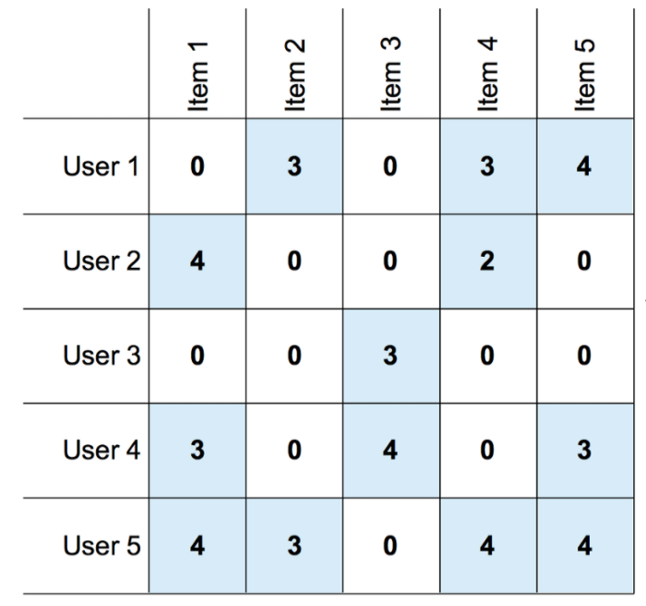
Step 1: Get User-Item Rating Data
m rows, where each row represents a user.
n columns, where each column represents a movie.
The values stored in each cell are the rating of a user to a target item.

Slide 15
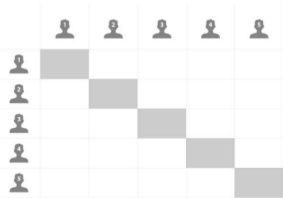
Step 2: Create User-User Similarity Matrix

Slide 16
Step 3: Look Up Similar Users

Slide 17
Step 4: Generate Candidate Items
Now we have similar users. We need to generate candidate movies to recommend.
First, let's start with the most similar user to you who is User 5 as we named Abraham.
User 5 has watched one movie that you haven’t watched yet. This is the Item 1.
Now we need to Predict the rating you would give to all items you have not watched yet.
Since you have not watched Item 1 and 3. We need to predict Item 1 and Item 3.

Slide 18
Step 5: Rank Candidates

Slide 19
Step 6: Filter Candidates
In a real-world situation, the output of step 5 would create hundreds or thousands of possible items and their prediction rating. Out of all possible candidates, we would take the highest 10 of them and show to the target user as the recommendations.

Slide 20
Case Study
??????

Slide 21
Conclusion
??????

